Slide 1
Original Ecosystems in Ecuador

Slide 2
Remaining Natural Formations: Ecological Footprint

Slide 3
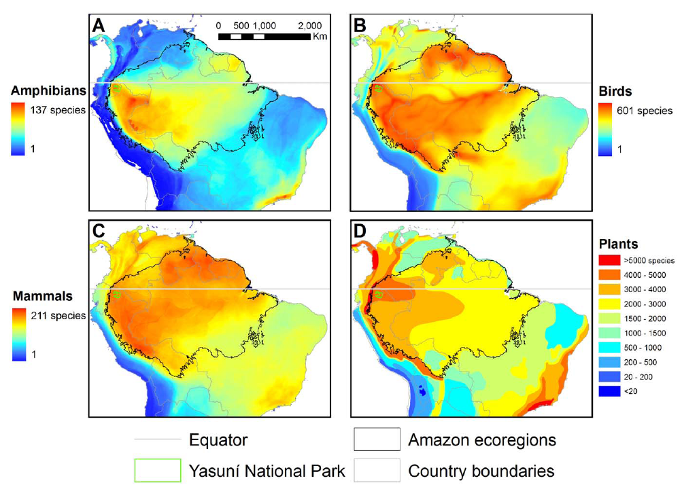
Biodiversity of Yasuni Park

Slide 4
Yasuni biodiversity overlap map

Slide 5
Amazon Deforestation and the Yasuni Park

Slide 6
The Auca Road

Slide 7
Block 31 Road inside Yasuni, Petroamazonas, 2013 (National Geographic Photo)

Slide 8
